Slide 1
Energy Efficiency Product Database

Slide 2
An online system through which applicants can apply for Letters of Authority to sell electronic appliances in South Africa

Slide 3
Applicant Portal
Regulator Portal
Public Portal
Through which applicants can submit details of their products and to apply for a LOA
Through which assessors can view and make decisions on applications
Through which public can check LOA of an appliance and compare energy efficiency

Slide 4
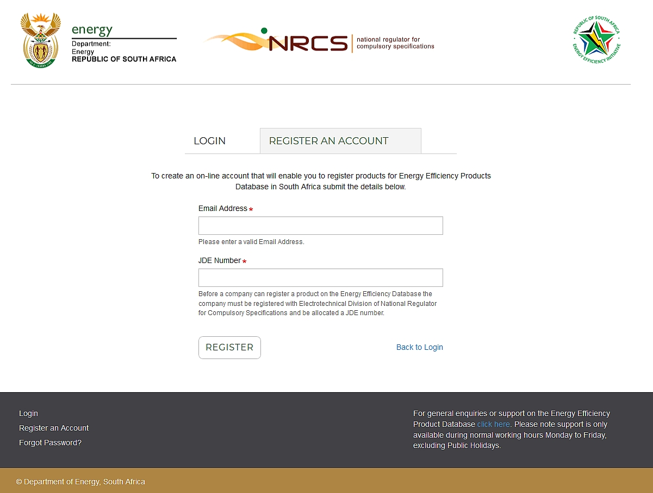

Slide 5
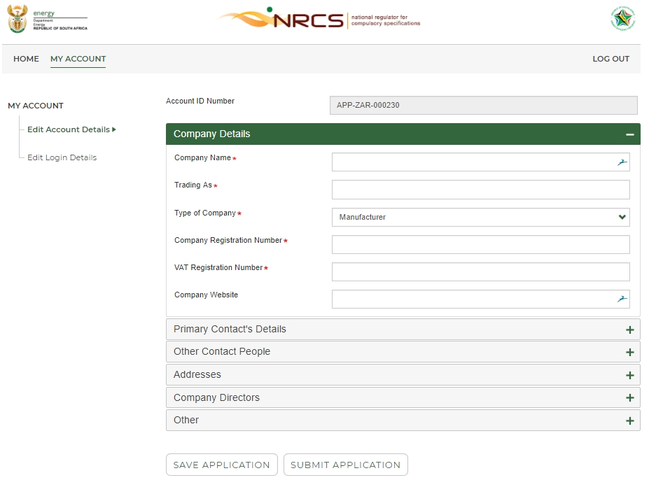

Slide 8
Benefits of the System - Applicant

Slide 9
Record of Applications submitted through the system

Slide 10
Automated notifications via email of a change in the status of applications
Submitted
Approved
Returned
Expired

Slide 11
Ability to check the status of an application at any time

Slide 12
Applications validated by the system
Reduces the possibility of submitting an application with an error
Reduces the possibility of having an application returned

Slide 13
Benefits of the System - Regulator

Slide 14
One central place for applications with easy search functionality

Slide 15
Applications validated by the system
Reduces the amount of work required of Regulator Staff
Reduces the number of returned applications
Reduces the turn around time for applications

Slide 16
Automated notifications via email of a change in the status of applications
Includes automated generation of a Letter of Authority once the regulator approves the application
Reduces the amount of work required of the regulator who no longer needs to draft correspondence to the applicant

Slide 17
Automated reports
Reduces the amount of work required of Regulator Staff as required reports can be automatically generated.
The impact of the regulations in terms of reduction in electricity use and Green House Gas emissions can be easily tracked.

Slide 18
Benefits of the System - Public

Slide 19
Easy to confirm if an appliance can be legally sold in South Africa

Slide 20
Ability to compare relative energy efficiency of appliances

Slide 21
Timelines

Slide 22
Applicant Portal
Regulator Portal
Public Portal
Test Site: Nov/Dec 2018
Test Site: Nov/Dec 2018
Test Site: Apr 2019
Live Site: Jan 2019
Live Site: Jan 2019
Live Site: May 2019

Slide 23
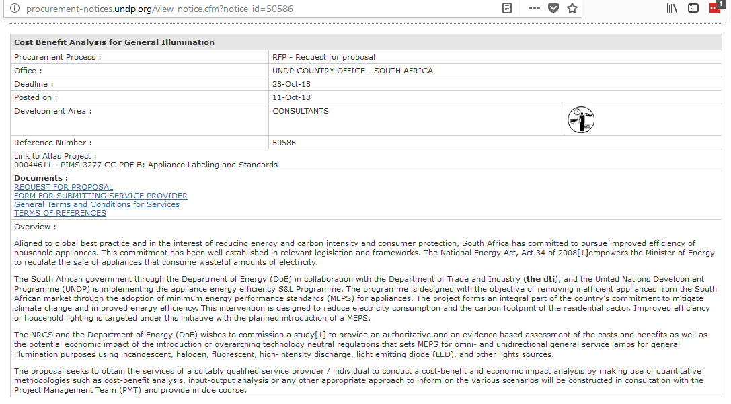

Slide 24
1) What are the estimated number of LED lamp types that will be regulated? Would each Type require an LOA which is valid for only three years?
2) While the introduction of LED lamps has rapidly replaced most other light sources over the last few years, can the need for a compulsory specification be justified, at the expense of the consumer and suppliers? (Traditional lamp types will phase out without NRCS intervention)
3) With known incapacity of LOA processing by NRCS and inability to conduct market surveillance testing, what is the benefit to the consumer, if these products are regulated? It is a known fact that no significant market surveillance testing has been conducted on other regulated lamp types ( tungsten filament lamps and CFL's).( NRCS spends less than 1% of its income on surveillance testing, the distribution of non-compliant products is not prevented).
4) Has a Regulatory Impact Assessment been conducted to determine whether regulation of this product is economically justified? What is the impact on the consumer? Has the option of not regulating the product at all been part of the Impact Assessment?

